Slide 1
Slide Show 5
JOEY’s music store
Instruments and accessories for all of your musical needs!

Slide 2

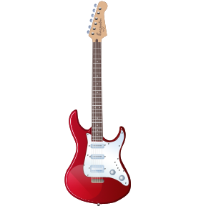

Products
Joey’s Music has the biggest selection of top of the line equipment for today’s musicians.
We carry every type of instrument used in popular music.
We have an impressive selection of world music instruments as well.
Store Hours: Monday Through Friday 11:00am - 9:00pm

Slide 3

Our history
Joey’s music was established in 1973, as a local music store in Santa Cruz, California. Since then, we have grown to be one of the nation’s largest and most popular music stores. We have locations in 24 U.S. states, and are constantly expanding. Come check out your local store to see what everyone is talking about!
Store Hours: Monday Through Friday 11:00am - 9:00pm

Slide 4

What our customers have to say…
“This store is amazing… Everything
I could ask for and MORE!”
- Tim Rocksalot, drummer
“I have never seen such a giant selection!”
- Glen Smith, guitarist
“You’ll never need to go anywhere else!
Thanks!”
- Karla Hutchinson, vocalist
“This place will surely put music stores
nationwide out of business!”
- Ben Ramos, producer
“I have found my new home…”
- Sara Jones, bassist

Slide 5
Come check us out!
Our main store is located at:
1526 N. Highland Ave.
Hollywood, CA 90028
Store Hours: Monday Through Friday 11:00am - 9:00pm

